Slide 1
Object Oriented Programming Lab CSE 1206
Lab 2

Slide 2
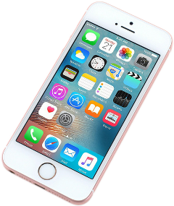
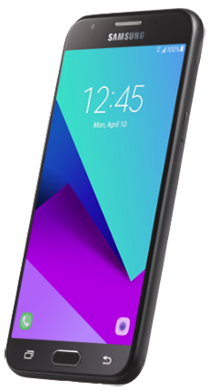
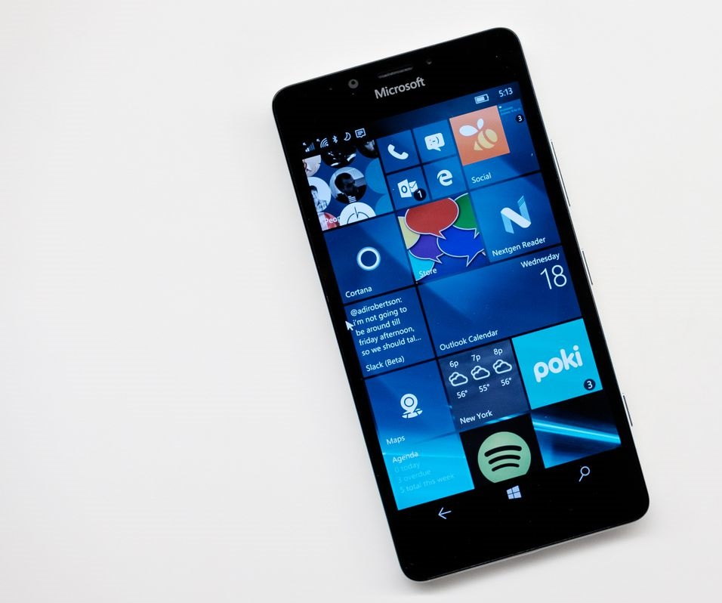
Java Class and Object
Class: SmartPhone
Object-1: iphone
Object-2 : Samsung phone
Object-3: Microsoft phone

Slide 3
Class
A basic smartphone has states or features like:
Makers
Operating System
Storage
Screen Size
Model
A basic smartphone has behaviors or functions like:
Power Duration
Camera
Interface
Each phone has its own features. So a class contains basic features and behaviors.
Fields

Slide 4
Java Class and Objects
A class is a new data type like int, double etc.
This data type is used to create objects.
So a class is a template for an object and an object is an instance of a class.

Slide 5
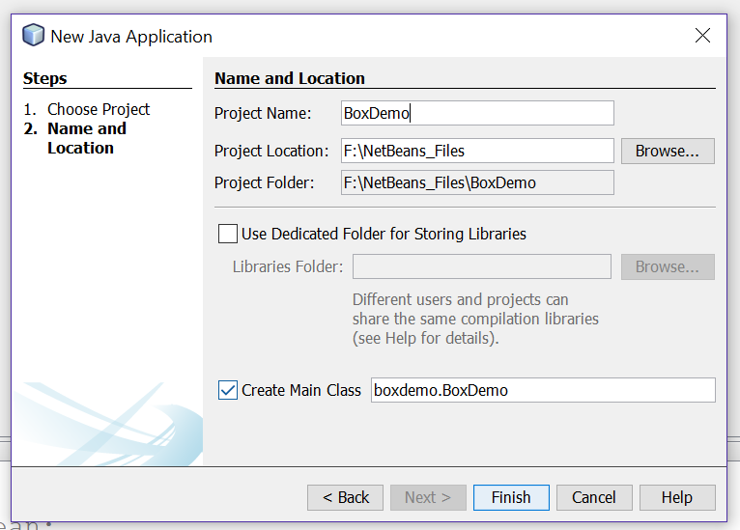
Create New Project

Slide 6
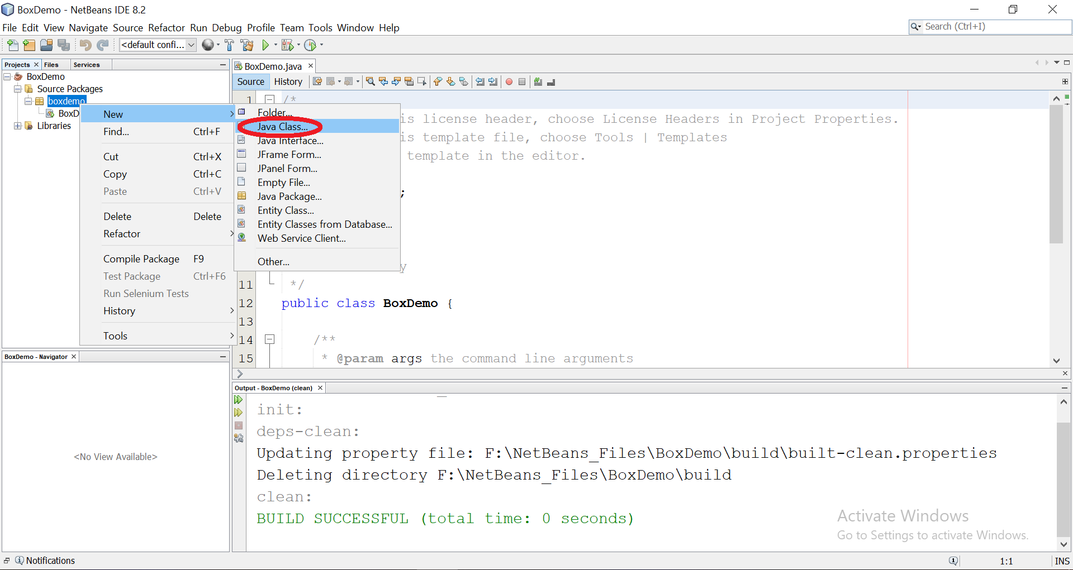

Slide 7
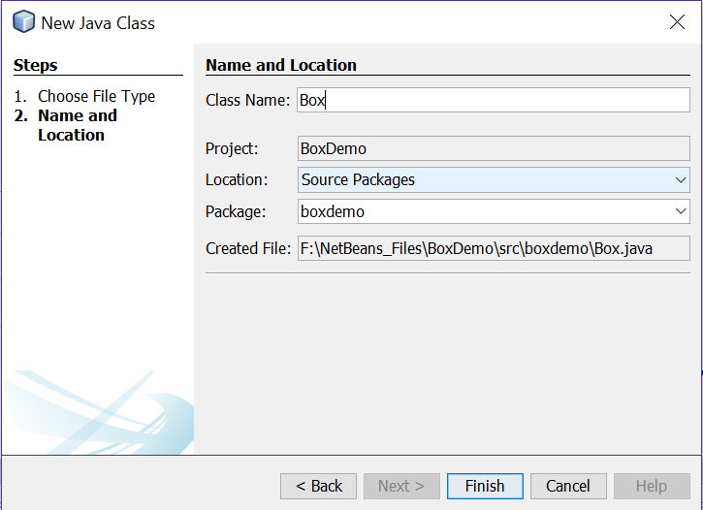
Create a Class Named Box

Slide 8
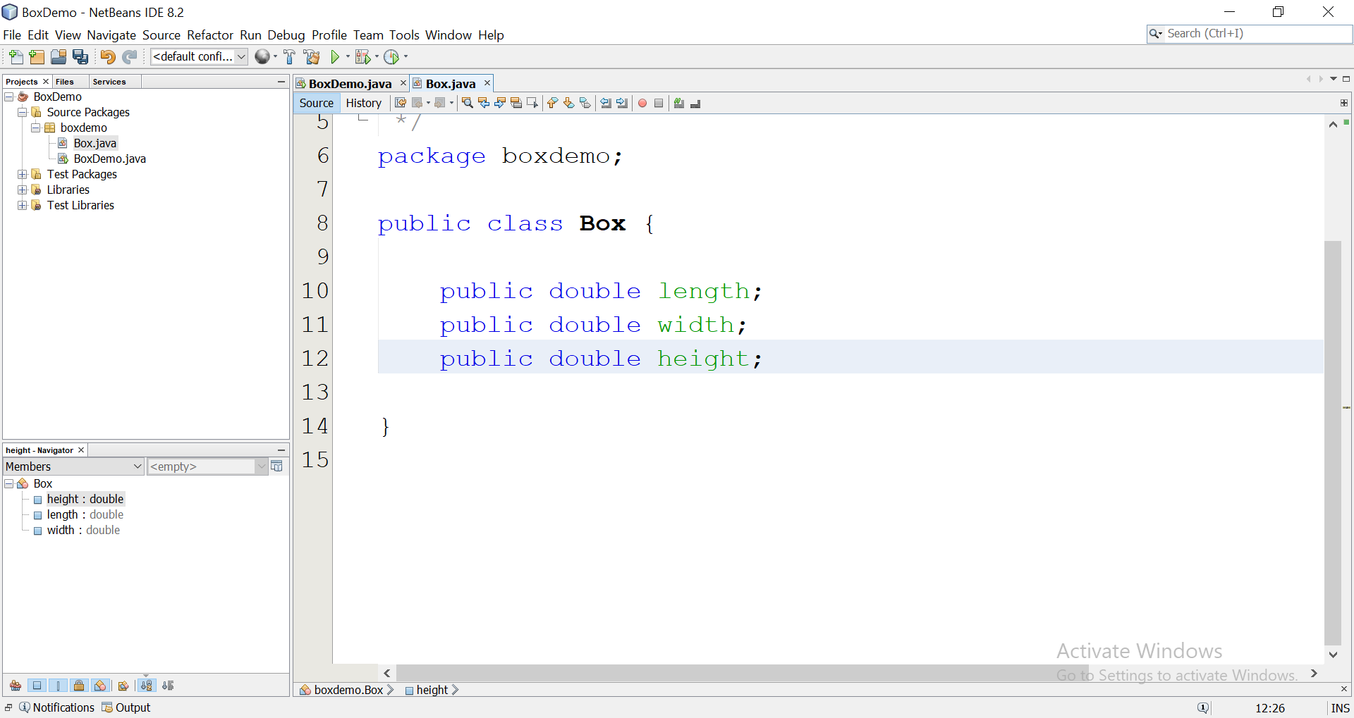

Slide 9
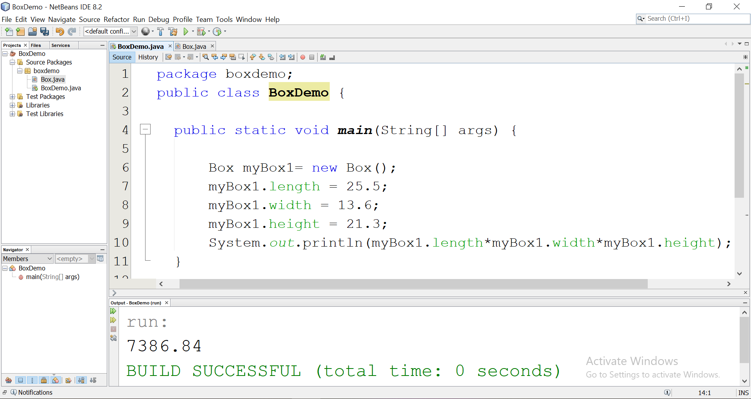

Slide 10
Introducing Methods

Slide 11
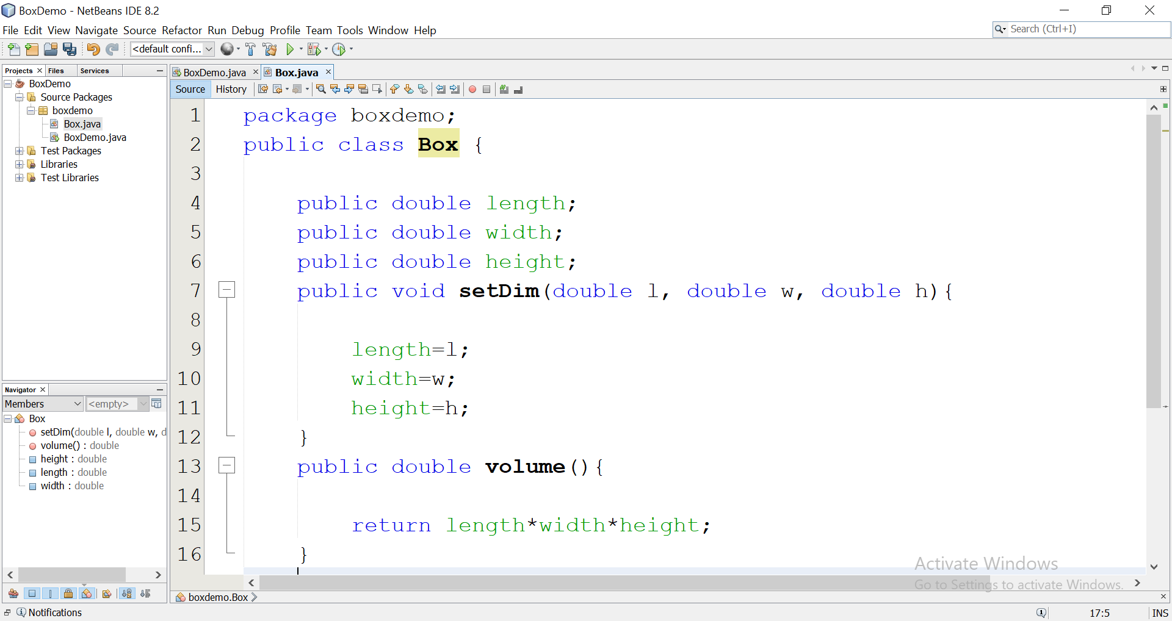

Slide 12
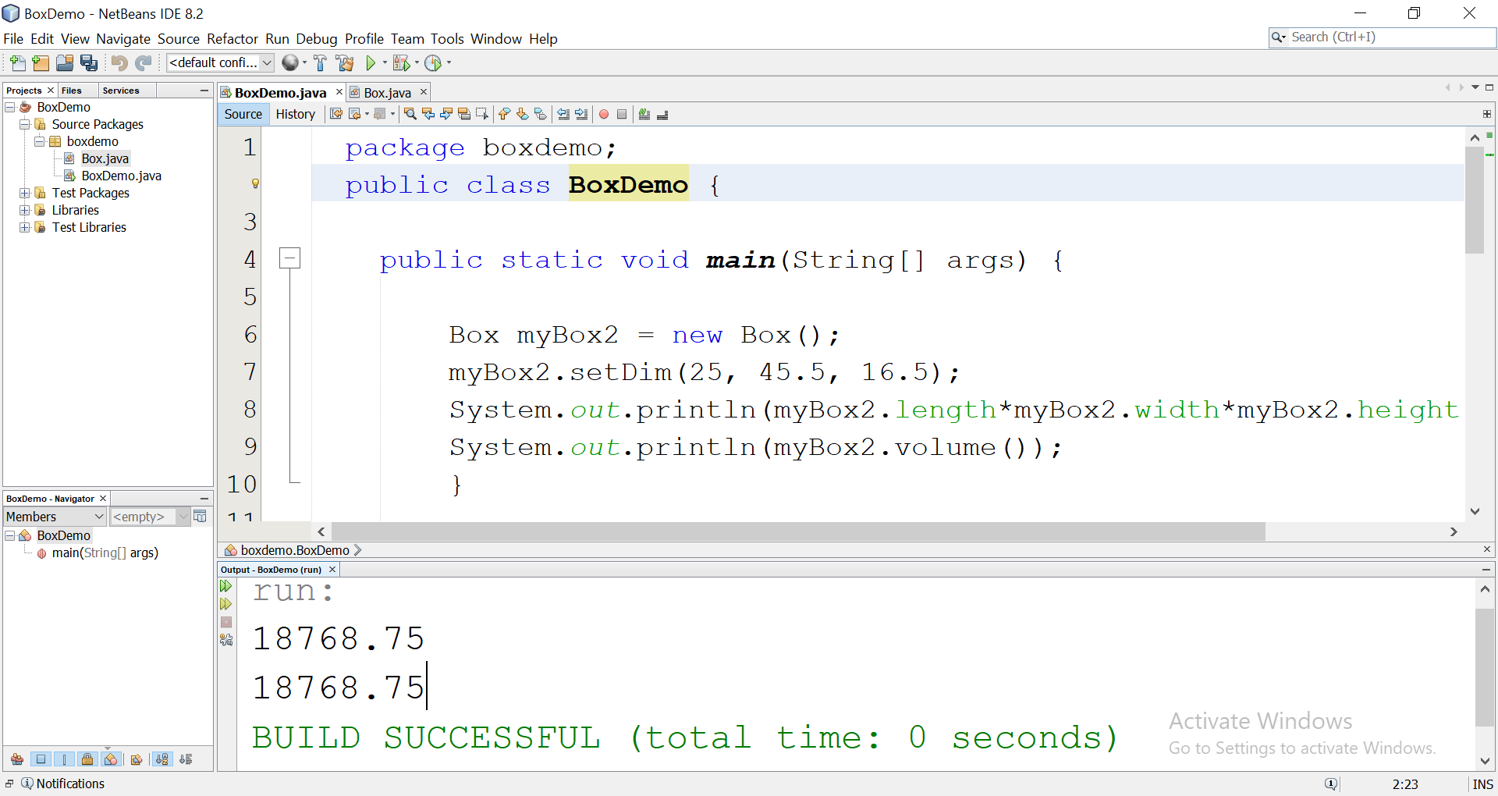

Slide 13
Constructors
Helps to initialize objects when they are created.
A constructor has the same name as the class.
Looks a method but has no return type. Not even void.

Slide 14
Constructor Overloading
creating constructors multiple times with different parameters.
smartphone(){
}
smartphone(double Storage, String Model){
}
smartphone(double Storage, String Model, double screenSize){
}

Slide 15
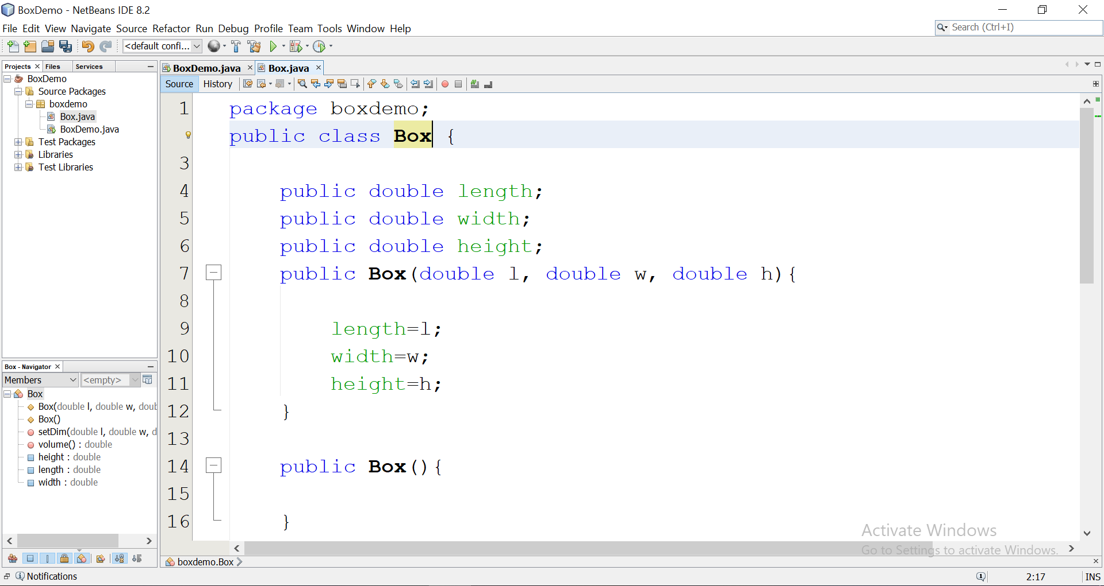

Slide 16
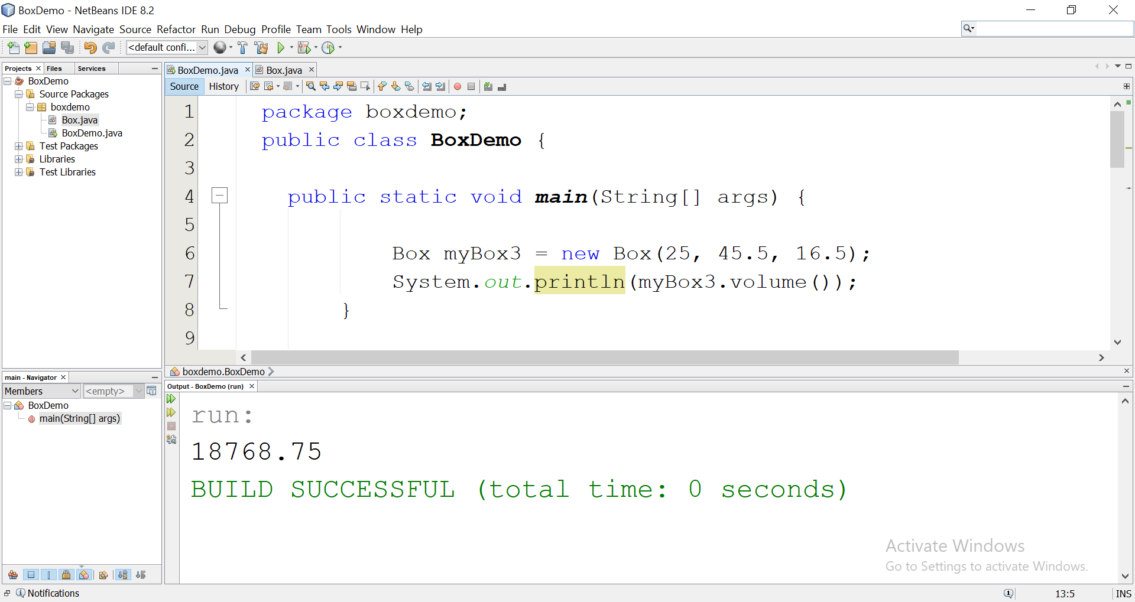

Slide 17
this Keyword

Slide 18
